Slide 1
CCNA 200-301, Volume I
Chapter 18
Troubleshooting IPv4 Routing

Slide 2
Objectives
Configure and verify IPv4 addressing and subnetting
Configure and verify IPv4 and IPv6 static routing

Slide 3
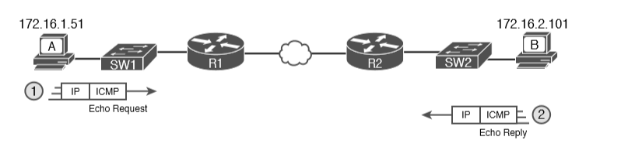
Ping
The ping command tests connectivity by sending packets to an IP address, expecting the device at that address to send packets back. The command sends packets that mean “if you receive this packet, and it is addressed to you, send a reply back.” Each time the ping command sends one of these packets and receives the message sent back by the other host, the ping command knows a packet made it from the source host to the destination and back.

Slide 4
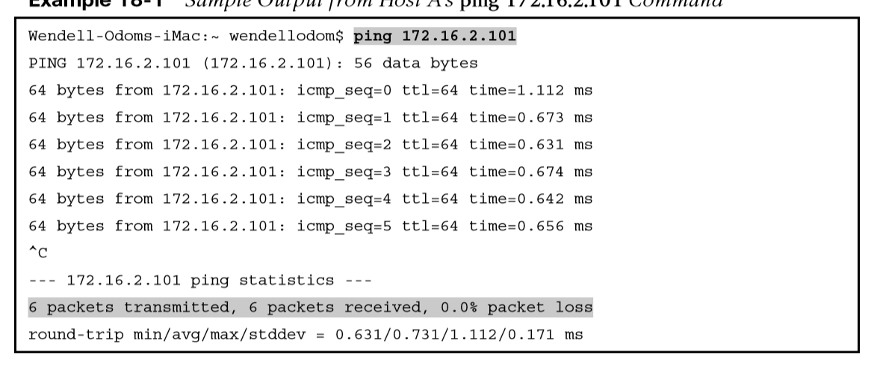
Sample Output of ping command

Slide 5
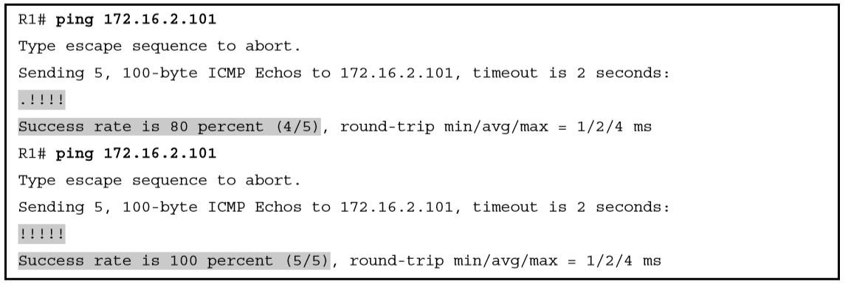
Router R2 Pings Host B (Two Commands)

Slide 6
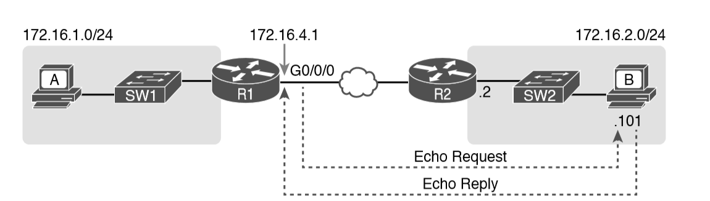
Standard ping 172.6.2.101 Command Using the Source Interface IP Address

Slide 7
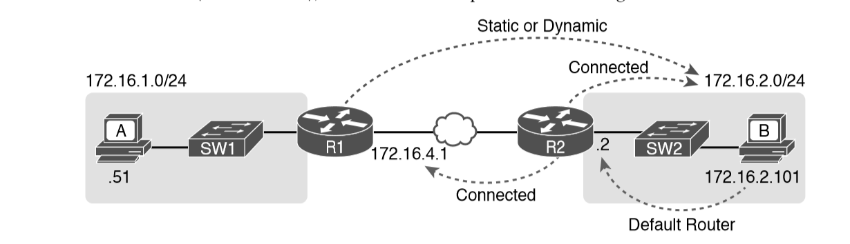
Layer 3 Routes Needed for R1’s Ping 172.16.2.101 to Work

Slide 8
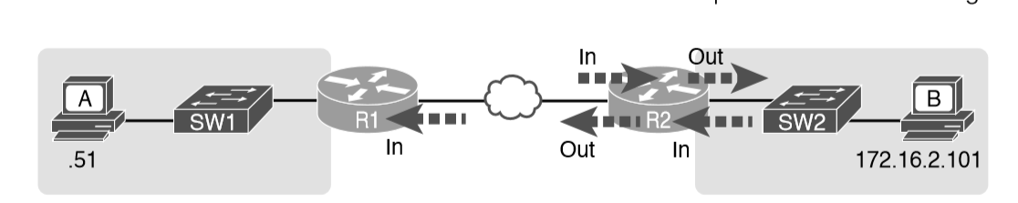
Locations Where IP ACLs Could Have Filtered the Ping Messages

Slide 9
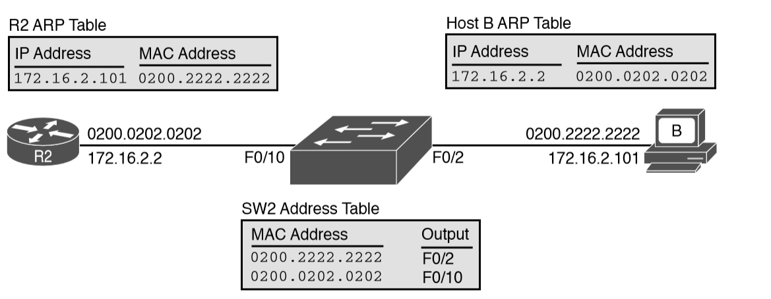
Router and Host ARP Tables, with the Switch MAC Address Table

Slide 10
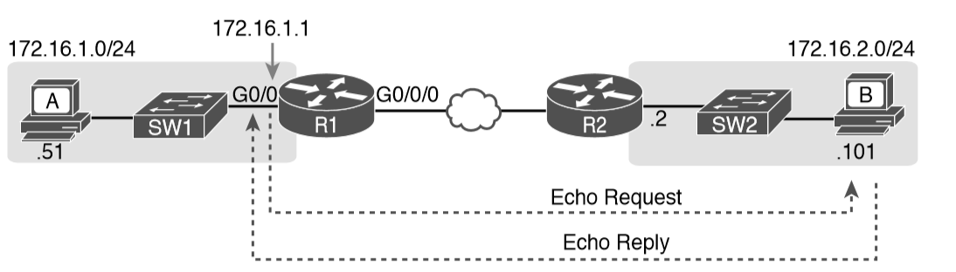
Extended Ping Command

Slide 11
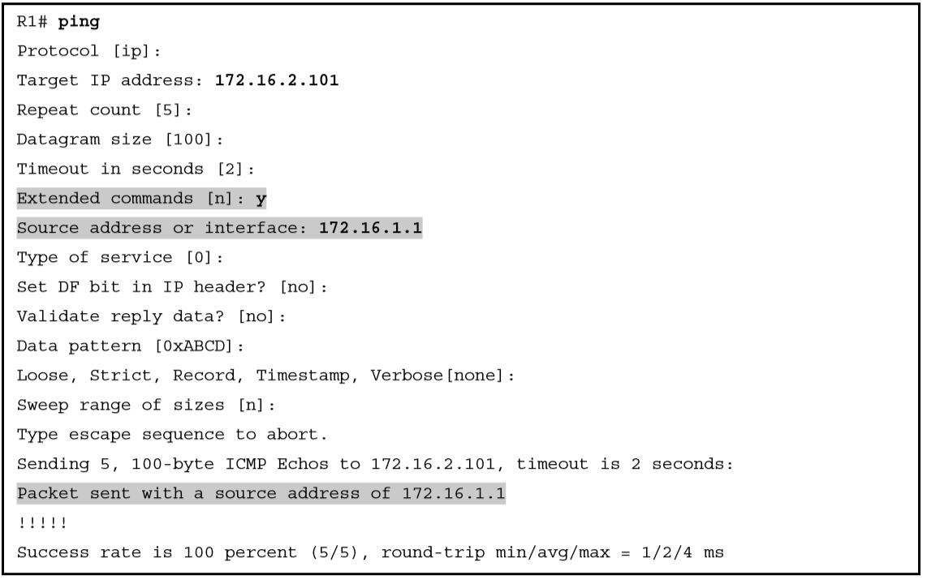
Extended Ping Command
The extended ping command does allow the user to type all the parameters on a potentially long command, but it also allows users to simply issue the ping command, press Enter, with IOS then asking the user to answer questions to complete the command, as shown in this example.

Slide 12
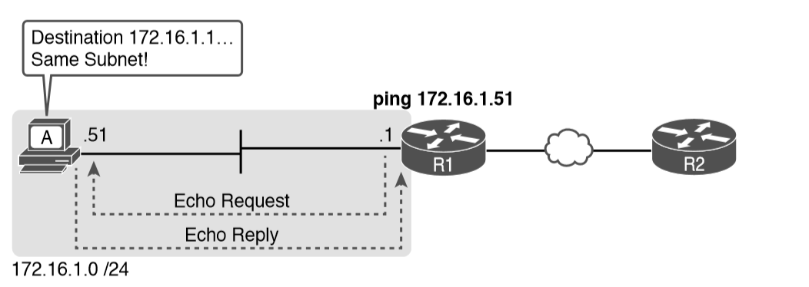
Testing LAN Neighbors with Standard Ping
If the ping works, it confirms the following, which rules out some potential issues:
The host with address 172.16.1.51 replied.
The LAN can pass unicast frames from R1 to host 172.16.1.51 and vice versa.
You can reasonably assume that the switches learned the MAC addresses of the router and the host, adding those to the MAC address tables.
Host A and Router R1 completed the ARP process and list each other in their respective Address Resolution Protocol (ARP) tables.
If the ping fails, it can point to a variety of problems such as:
IP addressing problem
DHCP problems
VLAN trunking problems
LAN problems

Slide 13
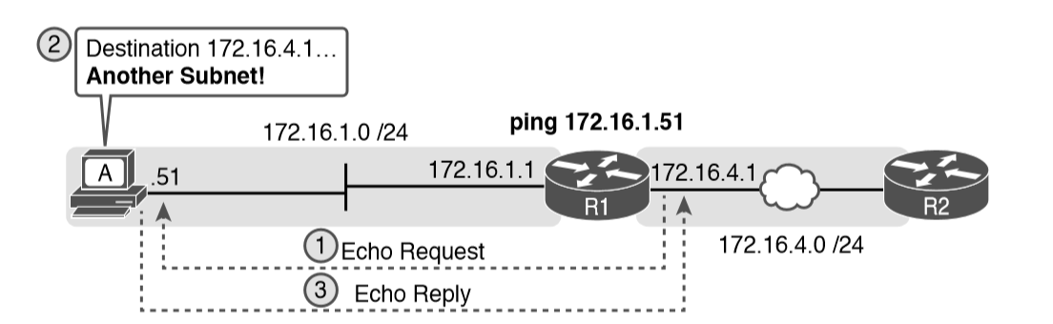
Testing LAN Neighbors with Extended Ping

Slide 14
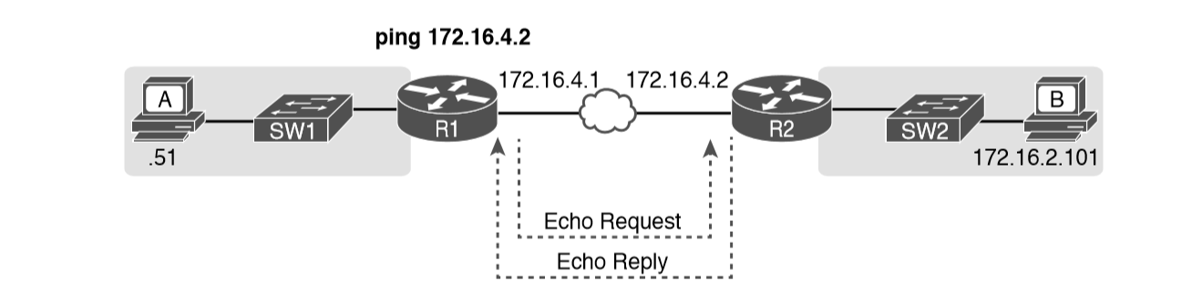
Testing WAN Neighbors with Standard Ping
A successful ping of the IP address on the other end of an Ethernet WAN link that sits between two routers confirms several specific facts, such as the following:
Both routers’ WAN interfaces are in an up/up state.
The Layer 1 and 2 features of the link work.
The routers believe that the neighboring router’s IP address is in the same subnet.
Inbound ACLs on both routers do not filter the incoming packets, respectively.
The remote router is configured with the expected IP address (172.16.4.2 in this case).

Slide 15
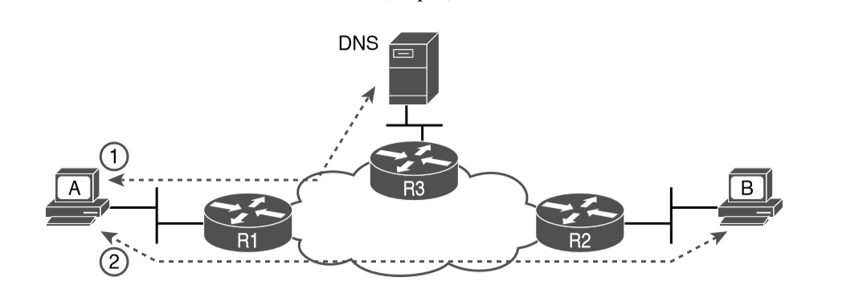
DNS Name Resolution by Host A

Slide 16
Problem Isolation Using the traceroute Command
Like ping, the traceroute command helps network engineers isolate problems. Here is a comparison of the two:
Both send messages in the network to test connectivity.
Both rely on other devices to send back a reply.
Both have wide support on many different operating systems.
Both can use a hostname or an IP address to identify the destination.
On routers, both have a standard and extended version, allowing better testing of the reverse route.

Slide 17
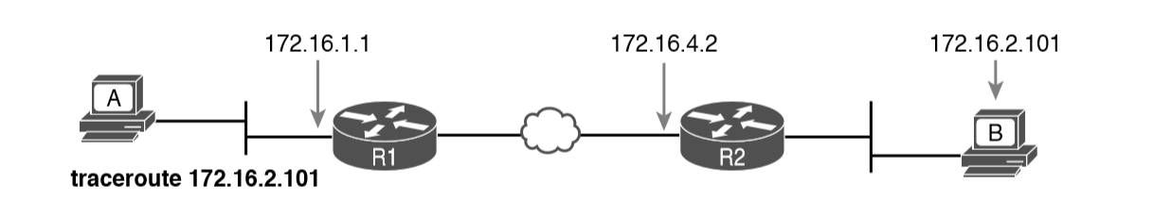
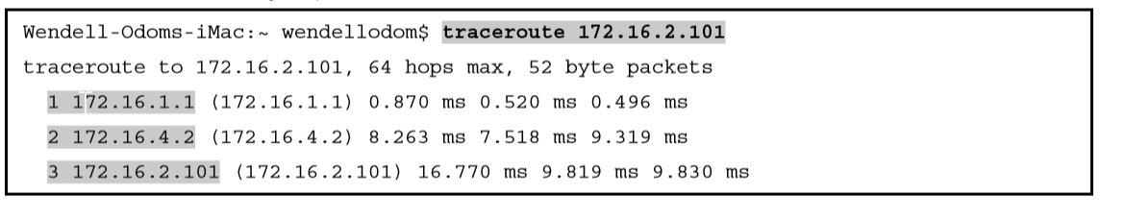
IP Addresses Identified by a Successful traceroute 172.16.2.101 Command

Slide 18
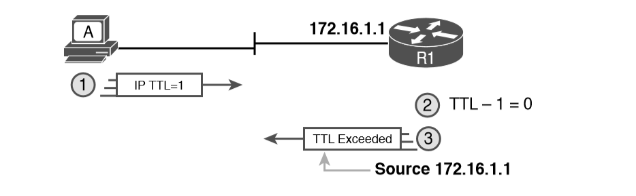
How traceroute Identifies the First Router in the Route
The traceroute command sends several TTL=1 packets, checking them to see whether the TTL Exceeded messages flow from the same router, based on the source IP address of the TTL Exceeded message. Assuming the messages come from the same router, the traceroute command lists that IP address as the next line of output on the command.

Slide 19
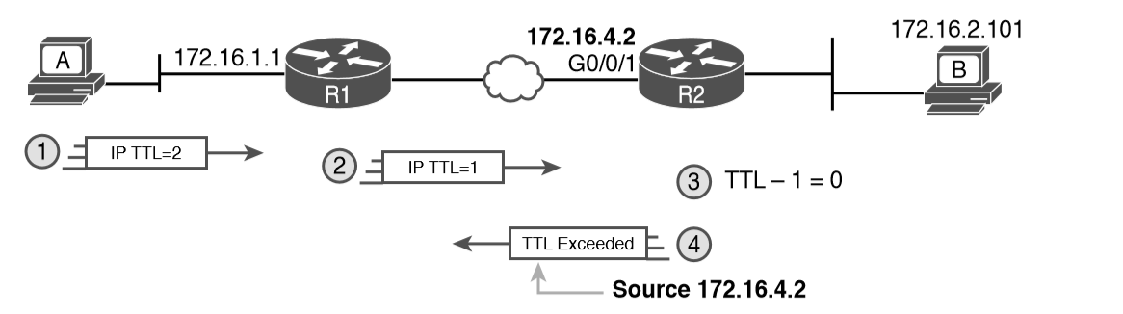
TTL=2 Message Sent by traceroute
To find all the routers in the path, and finally confirm that packets flow all the way to the destination host, the traceroute command sends a small set of packets with TTL=1, then a small set with TTL=2, then 3, 4, and so on, until the destination host replies.

Slide 20
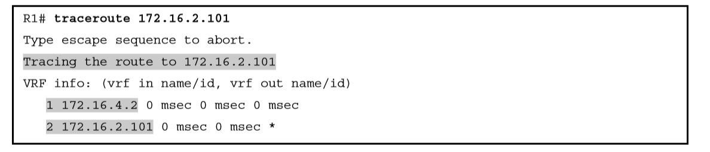
Standard traceroute Command on R1

Slide 21
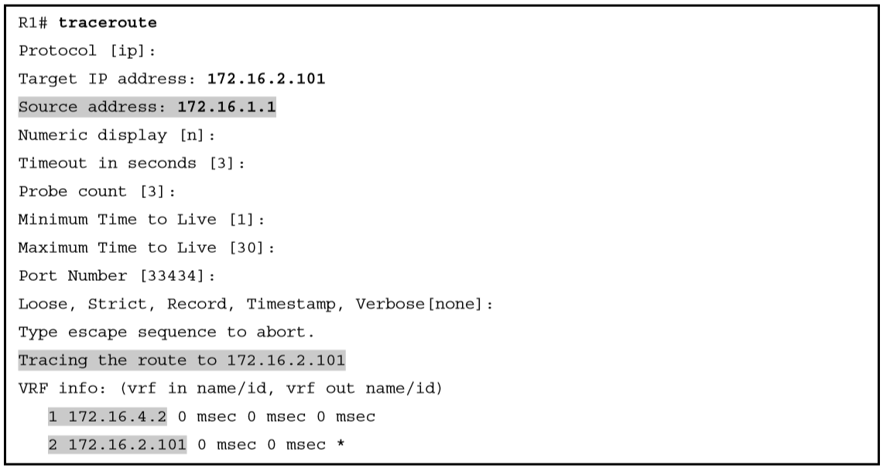
Extended traceroute Command on R1

Slide 22
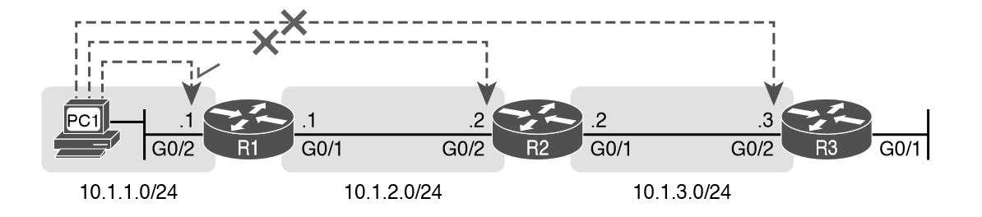
Telnet Works from PC1 to R1 but Not to R2 or R3

Slide 23
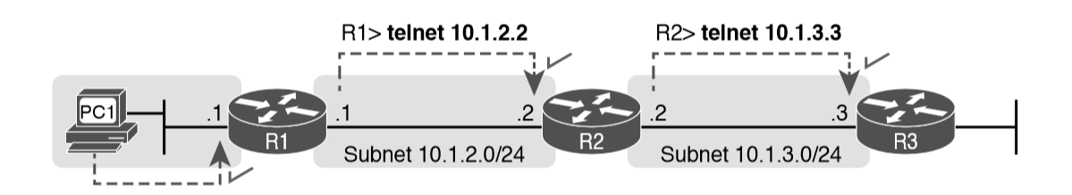
Successive Telnet Connections: PC1 to R1, R1 to R2, and R2 to R3

Slide 24
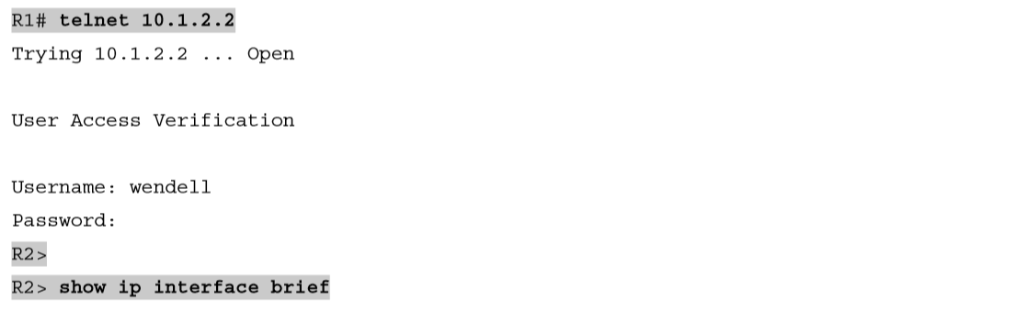
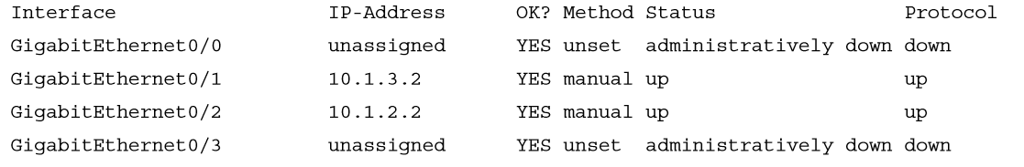
Telnet from R1 to R2 to View Interface Status on R2

Slide 25
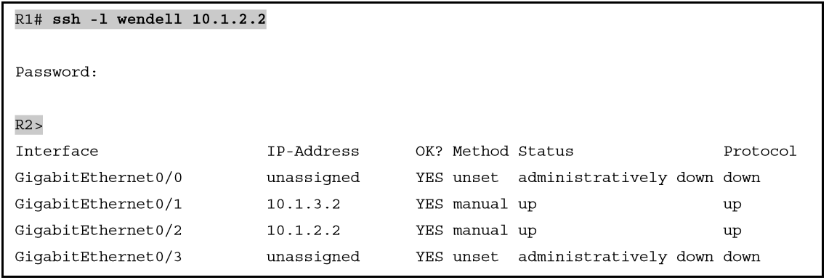
SSH Client from R1 to R2 to View Interface Status on R2

